Slide 1

SMART INDIA HACKATHON 2026
TITLE PAGE
Problem Statement ID – SIH26161
Problem Statement Title – Real-Time Hydrodynamic Simulation & HADR Decision Support Platform
Theme-PS Category- Software
Team ID- 180281
Team Name- UNEXPECTED ERRORS:(

Slide 2
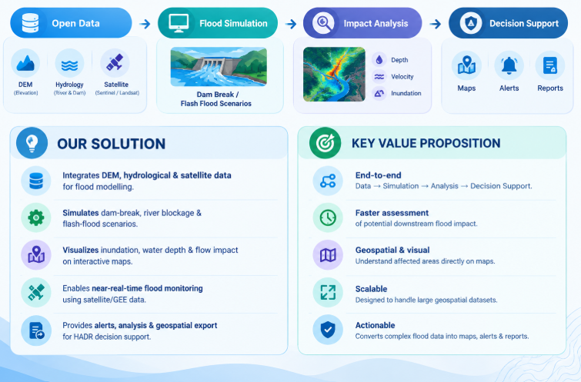
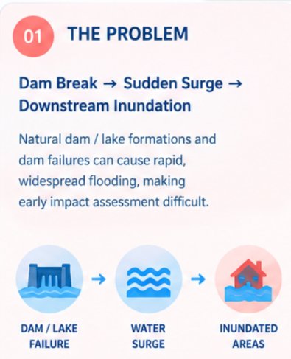
SURAKSHA-SETU
UNEXPECTED ERRORS
UNEXPECTED ERRORS:(

Slide 3
TECHNICAL APPROACH
UNEXPECTED ERRORS
UNEXPECTED ERRORS:(
01 Input Data →
02 Pre-processing →
03 Scenario Configuration →
04 Hydrodynamic Simulation →
05 Flood Impact Analysis →
06 GEE/Satellite Monitoring →
07 Visualization & Decision Support →
08 Export
TECH STACK:
🎨 Frontend-- HTML5, CSS, Bootstrap, JavaScript.
⚙️ Backend-- FAST APIs , REST APIs .
🗄️ Data & Database-- MySQL, DEM Data —elevation/topography, Hydrological & Dam Data.
🌍 Geospatial & Monitoring-- Google Earth Engine (GEE), GIS / Geospatial Processing, SHP / KML — geospatial output formats.
🌊 Hydrodynamic Modelling-- SPH (Smooth Particle Hydrodynamics), Deft3D
Process flow

Slide 4


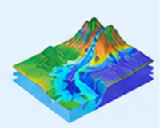





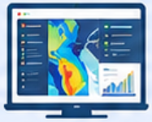


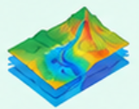


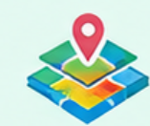





UNEXPECTED ERRORS:(
FEASIBILITY AND VIABILITY
FEASIBILITY
POTENTIAL CONCERNS
STRATEGIES TO RESOLVE
Technical
High Computation Demand
Cloud Parallel Execution
Dual hydrodynamic modelling pipeline combining Smoothed Particle Hydrodynamics (SPH) and Delft3D. Integrates high-resolution DEM and hydrological data to simulate dynamic breach discharge, velocity propagation, and peak flood wave routing across steep river valleys.
SPH and Delft3D hydrodynamics require substantial GPU/CPU resources, creating computational bottlenecks during wide-area catchment simulations.
Offload heavy satellite processing to Google Earth Engine and distribute hydrodynamic solvers across scalable cloud instances for rapid scenario runs.
Satellite Data Latency
Asynchronous Stream Hybrid
Sentinel-1 SAR constellation exhibits a 6 to 12-day revisit interval, limiting instantaneous observational verification during active sudden flash flood events.
Bridge the 6-12 day satellite revisit gap by coupling predictive hydrodynamic flow simulations with continuous live telemetry and dam water sensors.
Operational
Centralized GIS dashboard actively tracking 38 major Indian dams with customizable breach scenarios. Automatically computes the six vital impact metrics including inundation boundaries, exposed populations, and critical lifeline infrastructure to guide rapid HADR response operations.
Topographical Complexity
Dynamic DEM Integration
Steep Himalayan catchments and landslide dams (e.g., Rishi Ganga) produce non-linear surge kinetics and sudden debris-laden flood propagation.
Integrate localized high-resolution elevation data with adaptive mesh refinement to accurately map steep river valleys and sudden breach kinetics.
Impact Quantification
Automated Exposure Engine
Economical
Accurately assessing submerged road networks, agricultural losses, and critical hospitals requires integrating diverse geospatial demographic layers.
Overlay inundation boundaries onto OpenStreetMap and census layers to automatically calculate exposed populations, cropland, and road cutoffs.
Leverages fully open-source Sentinel-1 SAR satellite imagery and offloads intensive raster computations to serverless Google Earth Engine pipelines. Drastically reduces proprietary software licensing costs and infrastructure overhead for state and national disaster agencies.
Large Volume Datasets
Format Standardization
Ingesting multi-temporal raster arrays, national DEM files, and continuous hydrological time-series creates significant data handling bottlenecks.
Automate processing pipelines to instantly export flood extents, velocity contours, and reports in interoperable .shp, .kml, and GeoJSON formats.
4

Slide 5

UNEXPECTED ERRORS:(
IMPACT AND BENEFITS
National & State Disaster Agencies
Socio-Economic Benefits
Shifts response from reactive rescue to proactive HADR planning. The centralized dashboard provides near real-time inundation boundaries, enabling targeted evacuation before the flood wave hits.
•
Proactive identification of 38 major Indian dams protects critical infrastructure (hospitals, major highways) and significantly reduces post-disaster rebuilding expenses.
•
Rapid computation of exposed populations and submerged cropland safeguards local farmer livelihoods and stabilizes regional food security.
Dam Authorities & Operators
Provides data-backed hydrodynamic simulations of breach kinetics. Operators can visually optimize water release schedules safely without cascading risks or departmental blind spots.
•
Offloading intensive Sentinel-1 SAR processing to Google Earth Engine drastically cuts proprietary software licensing costs for state governments.
IMPACTS
BENEFITS
At-Risk Communities & Citizens
Environmental Benefits
Drastically reduces vulnerability to sudden flash floods (e.g., Rishi Ganga). Early warnings and mapped exposure estimates secure critical lifelines, providing life-saving lead time.
•
Minimizes ecological devastation by actively simulating and preparing for sudden debris-laden flash floods in fragile topographies like steep Himalayan catchments.
•
Tracks and mitigates the localized downstream impact of artificial river blockages and natural lake outbursts (GLOFs), protecting basin biodiversity.
Policy Makers & Urban Planners
Delivers concrete geospatial impact data—including submerged road networks and agricultural losses—to confidently guide budget allocations and resilient infrastructure capital expenditure.
•
Optimized computational pipeline utilizes serverless cloud infrastructure, minimizing the carbon footprint associated with heavy bare-metal GIS processing.
2
5

Slide 6

UNEXPECTED ERRORS:(
RESEARCH AND REFERENCES
India-WRIS: https://indiawris.gov.in/wris/#/Used in Google Earth Engine as the primary national repository to extract precise geographic pinpoint coordinates, catchment bounding boxes, and structural specifications for key Indian dam structures.
GRaND Database: https://www.globaldamwatch.org/grandReferenced as a global georeferenced database to map reservoir surface areas and sub-catchment boundary extents for major dam basins for Google Earth Engine.
Google Earth Engine (GEE): https://earthengine.google.com/
Used to develop the framework for near real-time flood analysis, enabling the processing of large volumes of open-source satellite imagery and DEM datasets.
Copernicus Open Access Hub (Sentinel-1 SAR): https://scihub.copernicus.eu/
Referenced for accessing 6 to 12-day stream Synthetic Aperture Radar (SAR) data, crucial for computing real-time inundation without cloud interference.
ISRO Bhuvan Indian Geo-Platform: https://bhuvan.nrsc.gov.in/
Used as a primary reference for mapping predefined major Indian dams, hydrological data, and generating baseline terrain topologies for localized river basins.
OpenStreetMap (OSM) Overpass API: https://overpass-turbo.eu/
Integrated to dynamically extract data on road networks, hospitals, and critical infrastructure to accurately compute the 6 hazard parameters in impacted zones.
MERIT Hydro (v1.0.1) – HAND Layer: https://global-hydrodynamics.github.io/MERIT_Hydro/Used in Google Earth Engine as a hydrological proximity constraint (Height Above Nearest Drainage) to eliminate topographic false positives and restrict detected flood inundation to plausible river channels.
6

